Slide 1
The Decision Support Tool
Team 15
Nino Spasik, Austin Sun, Adam Syed, Amy Tai,
Hiba Tawfeeq, Richard Uong

Slide 2
Goals for Our Decision Support Tool (DST)
Potential Solutions Using DST
Potential Problems in a Project
DST allows user to constantly update deadlines, time available per week. Algorithms take into consideration available time of member when matching with task
Bad time management
Insufficient communication
Difficulty completing tasks
Lack of "Big Picture"
DST lets the user input their skill level on multiple competencies and available hours per week to work on project, this information is shared amongst other members
"Mentor Matching" feature allows highly skilled members to pair up with lower skilled members of a certain competency and teach them that specific skill
DST has various displays of the project tasks as a whole. The "Assignment Table" and "Project Tasks" pages offers users an overview of the project's progression

Slide 3
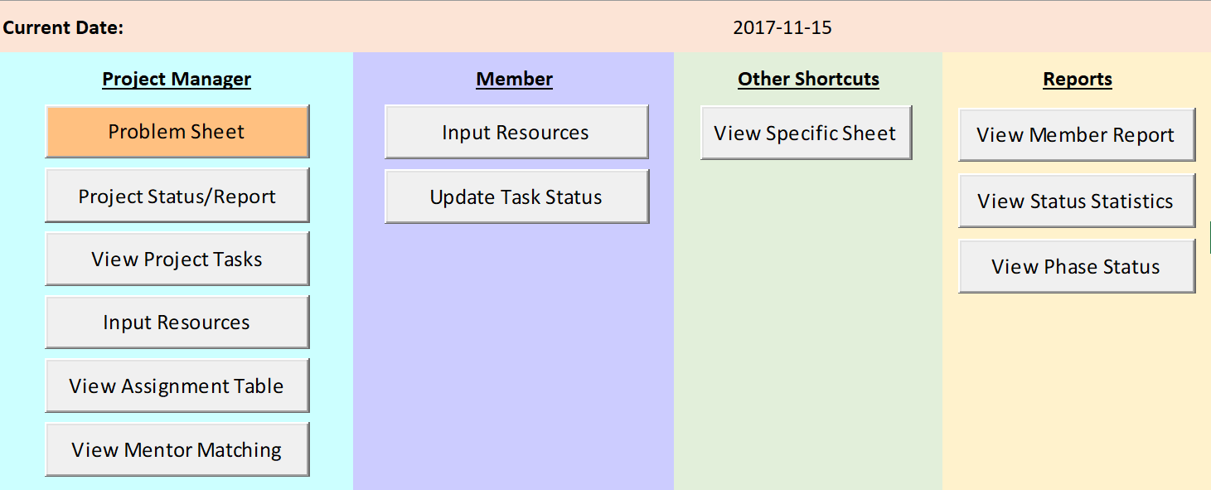
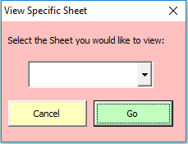
Home Page
Notes:
You have the option to select a specific sheet to view from the homepage using this button.
Other buttons will be covered in detail in the upcoming slides.

Slide 4
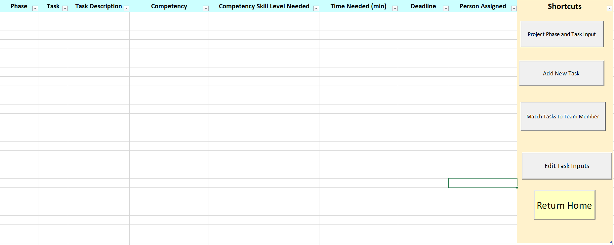
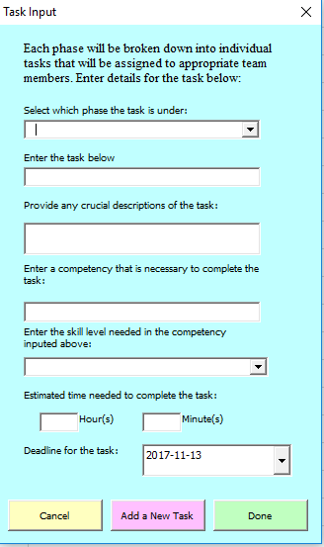
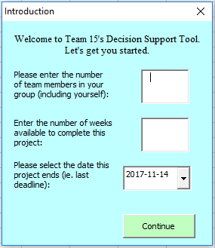
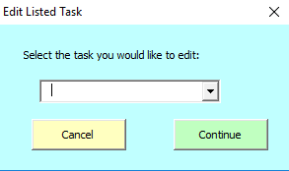
Project Input

Slide 5
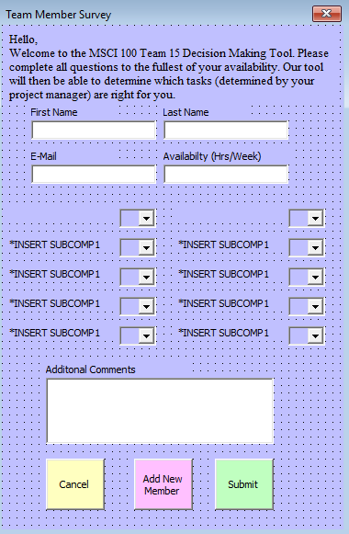
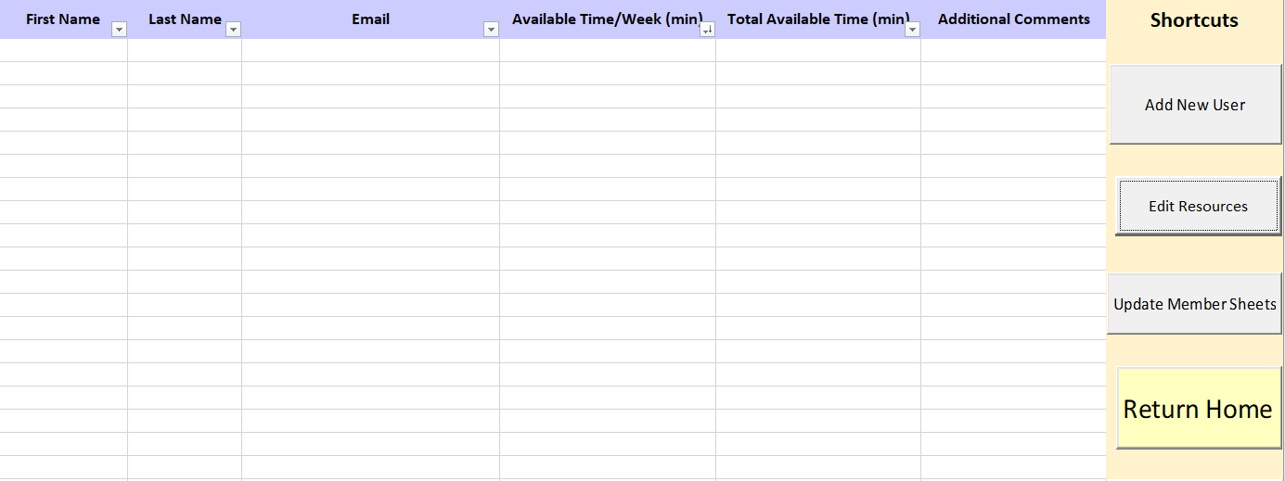
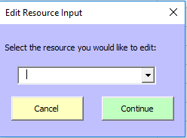
Resources

Slide 6
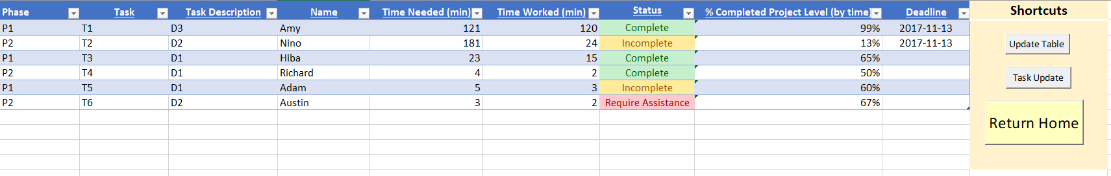
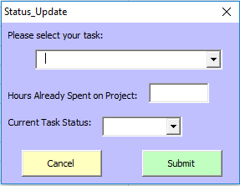
Assignment Table
Syncs the Assignment Table with the most recent data from User Forms and other sheets

Slide 7
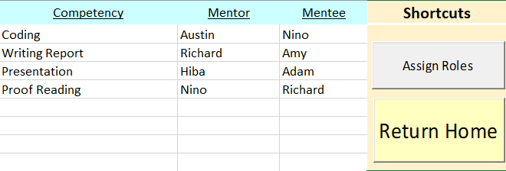
Mentor Matching

Slide 8
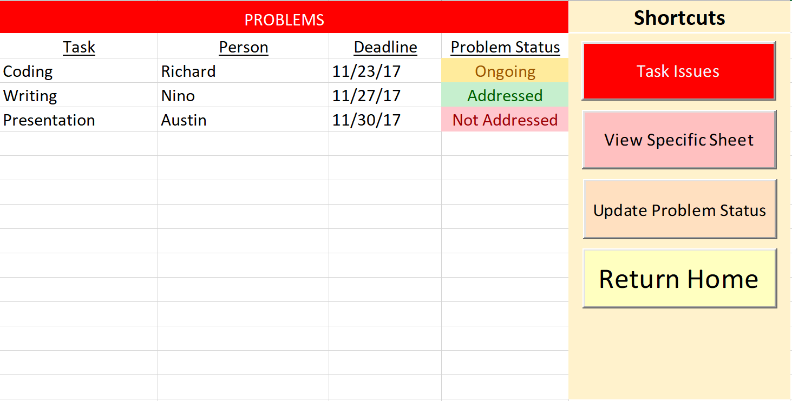
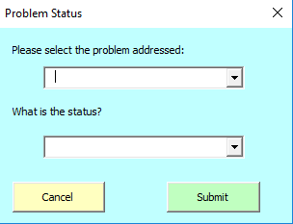
Problem Sheet

